Slide 1

Introduction to Governance, Risk, and Compliance
GRC101
International Cybersecurity and Digital Forensics Academy (ICDFA)
Governance, Compliance, and Risk (GCR) Track
Week 1: Overview of GRC Frameworks and Principles
Understanding GRC fundamentals and concepts

Slide 2


Learning Objectives
Upon completion of this module, you will be able to:
Define and explain
the core concepts of Governance, Risk, and Compliance and their interrelationships
Identify and describe
the key components of major GRC frameworks including NIST CSF, COSO, ISO 27001,
and COBIT
Analyze and evaluate
organizational GRC requirements and implementation challenges in cybersecurity
contexts
Apply fundamental GRC principles
to develop basic governance structures, risk assessment methodologies,
and compliance processes
Articulate the value
of integrated GRC approaches for organizational security posture and operational
efficiency
GRC101 - International Cybersecurity and Digital Forensics Academy

Slide 3
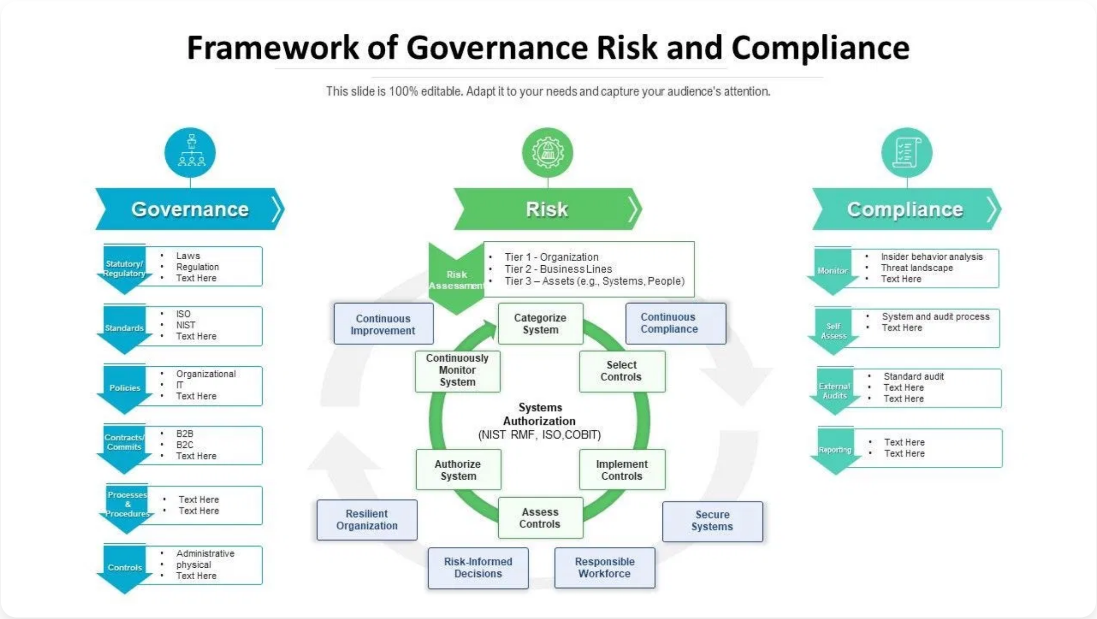

What is GRC?
Governance, Risk, and Compliance (GRC)
is an
integrated approach to organizational governance
that ensures entities act ethically correct while
managing risks and meeting regulatory requirements.
Strategic Framework
: Aligns IT with business objectives
while managing risks
Holistic Approach
: Breaks down silos between
departments and processes
Risk Reduction
: Identifies, assesses, and mitigates
organizational risks
Regulatory Adherence
: Ensures compliance with laws,
regulations, and standards
GRC101 - International Cybersecurity and Digital Forensics Academy

Slide 4

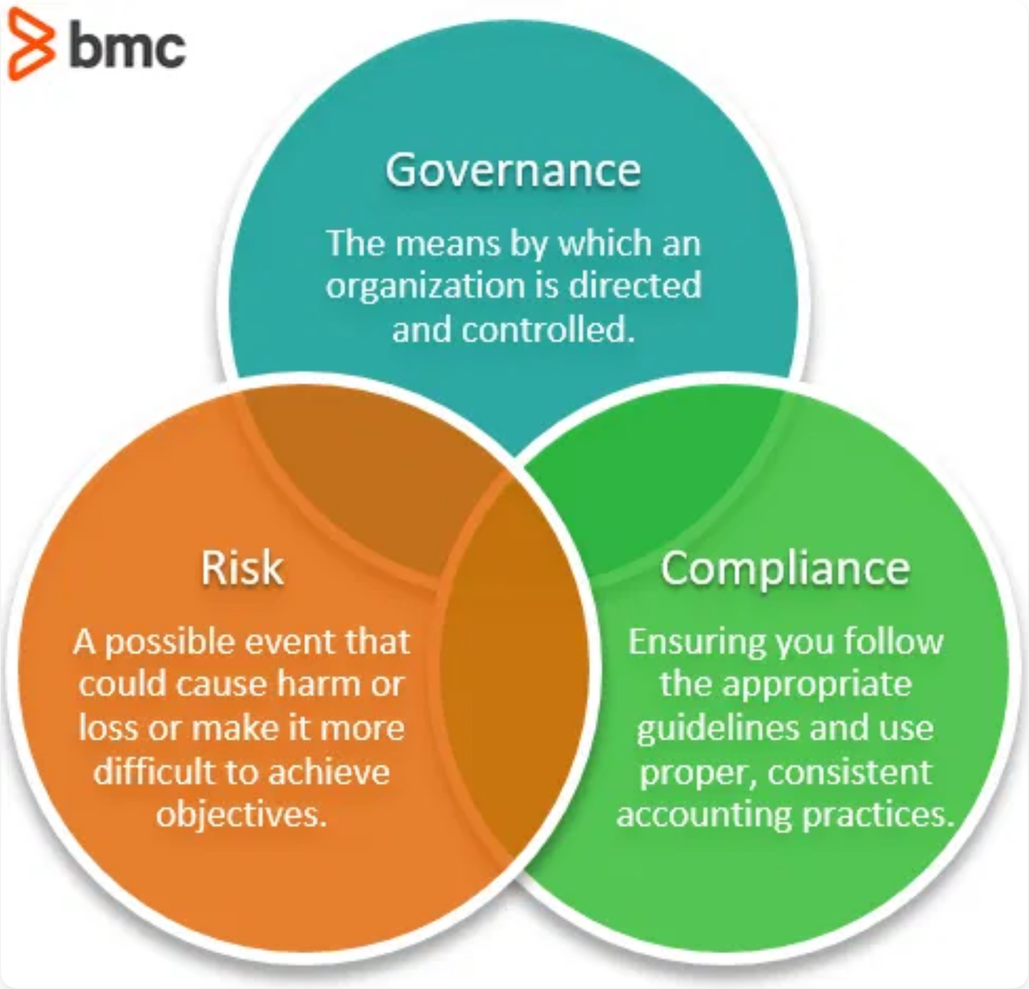


The Three Pillars of GRC
Governance
The policies, processes, and structures that direct and control organizational activities to achieve objectives. Ensures leadership, organizational roles, and responsibilities are clearly defined.
Risk Management
The identification, assessment, and prioritization of risks followed by coordinated application of resources to minimize, monitor, and control the probability or impact of unfortunate events.
Compliance
The process of adhering to internal policies and procedures as well as external laws, regulations, and standards. Ensures the organization meets its legal and ethical obligations.
GRC101 - International Cybersecurity and Digital Forensics Academy

Slide 5
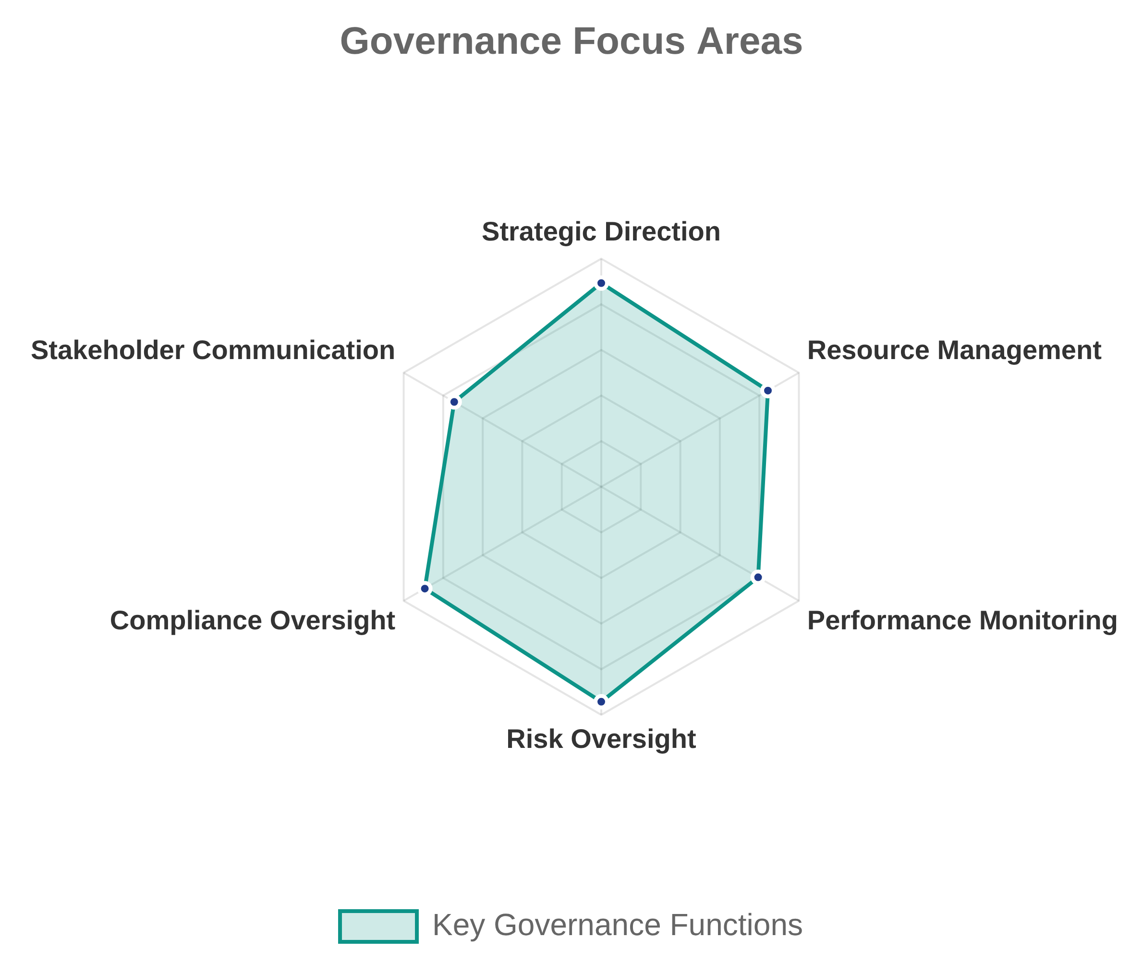




Governance Deep Dive
Governance
refers to the system of rules, practices,
and processes by which an organization is directed
and controlled to achieve its objectives while
balancing stakeholder interests.
Organizational Structure
: Defines roles, responsibilities,
and reporting lines for decision-making and accountability
Policies & Procedures
: Establishes guidelines and
standards for organizational activities and behavior
Oversight & Control
: Ensures resources are properly
utilized and activities align with strategic objectives
Stakeholder Management
: Balances interests of
shareholders, employees, customers, and other
stakeholders
GRC101 - International Cybersecurity and Digital Forensics Academy

Slide 6
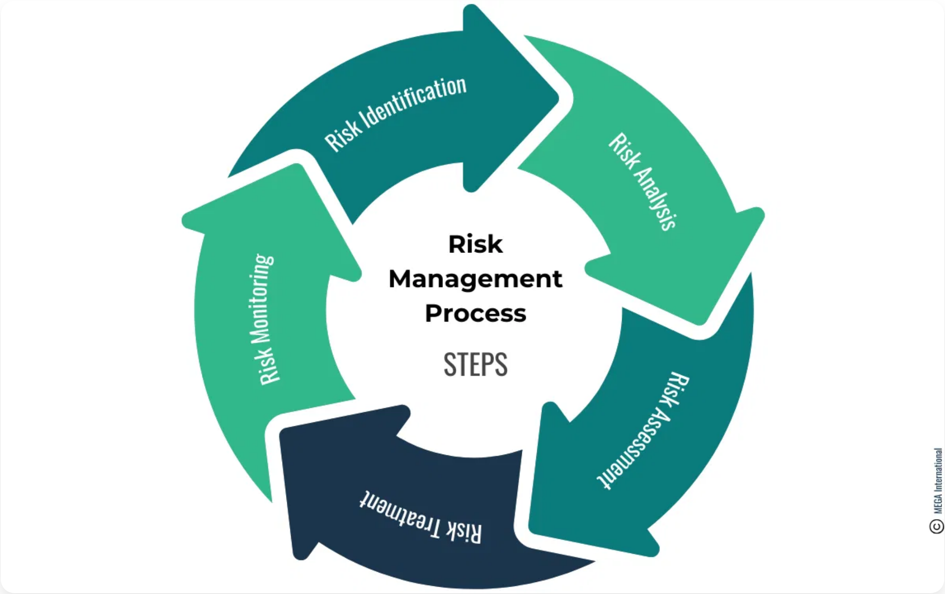
Risk Management Deep Dive
Risk Management
is the process of identifying,
assessing, and controlling financial, legal, strategic,
and security risks to an organization's capital and
earnings.
1
Risk Identification
: Discover and document potential threats
and vulnerabilities that could negatively impact business
objectives
2
Risk Assessment
: Analyze and evaluate the likelihood and
potential impact of identified risks
3
Risk Treatment
: Develop and implement strategies to mitigate,
transfer, avoid, or accept risks
4
Risk Monitoring
: Continuously track and review risks and the
effectiveness of controls
5
Risk Reporting
: Communicate risk status to stakeholders and
leadership
GRC101 - International Cybersecurity and Digital Forensics Academy

Slide 7

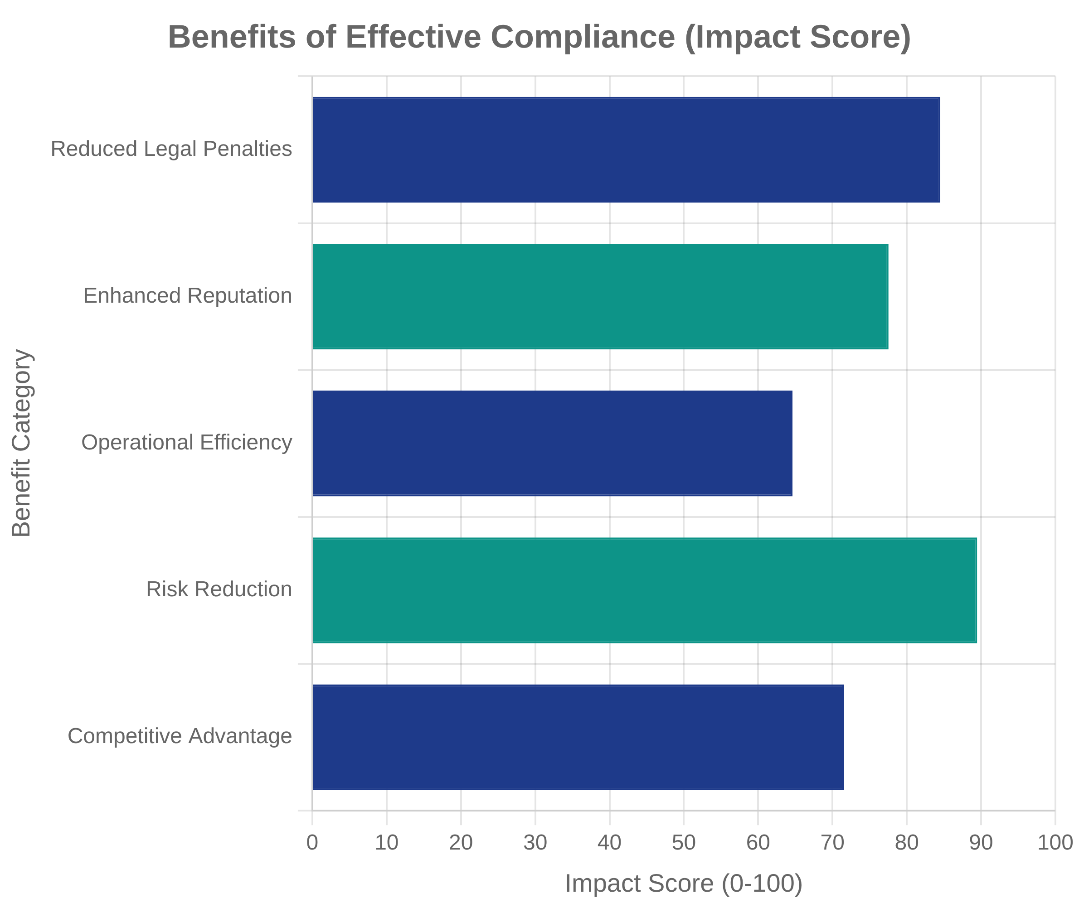




Compliance Deep Dive
Compliance
refers to an organization's adherence to
laws, regulations, guidelines, and specifications
relevant to its business processes. Compliance
programs are designed to ensure that companies
follow all applicable rules and regulations.
Internal Compliance:
Adherence to organizational policies,
procedures, and standards established by the company itself
External Compliance:
Adherence to laws, regulations, and
industry standards imposed by external authorities (e.g., GDPR,
HIPAA, SOX)
Cybersecurity Compliance:
Adherence to frameworks and
standards specifically designed to protect information systems
and data (e.g., NIST CSF, ISO 27001)
Operational Compliance:
Day-to-day activities that ensure
business processes align with regulatory requirements and
internal policies
GRC101 - International Cybersecurity and Digital Forensics Academy

Slide 8








Key GRC Frameworks
NIST Cybersecurity Framework
COSO Framework
A voluntary framework of standards, guidelines, and best practices to manage cybersecurity risk.
Provides guidance on enterprise risk management, internal control, and fraud deterrence.
Six core functions: Govern, Identify, Protect, Detect, Respond, Recover
Five components: Control Environment, Risk Assessment, Control Activities, Information & Communication, Monitoring
Flexible implementation for organizations of all sizes
Risk-based approach to cybersecurity management
Focuses on organizational objectives and internal controls
Widely adopted for financial reporting compliance
ISO 27001
COBIT
International standard for information security management systems (ISMS).
Framework for IT governance and management created by ISACA.
Bridges the gap between business goals and IT governance
Risk-based approach with 114 controls across 14 domains
40 governance and management objectives
Plan-Do-Check-Act (PDCA) methodology
Focuses on value creation, risk optimization, and resource optimization
Certification available to demonstrate compliance
GRC101 - International Cybersecurity and Digital Forensics Academy

Slide 9
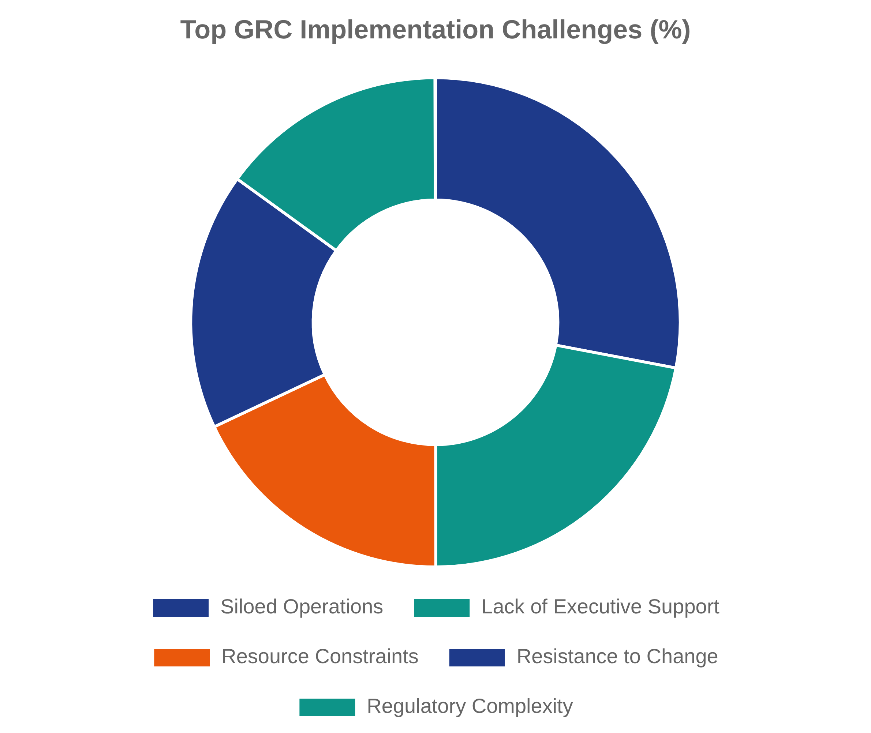


GRC Implementation Challenges
Organizations face numerous challenges when implementing GRC programs. Understanding these obstacles and their solutions is critical for successful implementation.
Siloed Operations
Solution: Integrated GRC platforms and cross-functional teams
Lack of Executive Support
Solution: Demonstrate ROI and risk reduction benefits
Resource Constraints
Solution: Phased implementation approach and automation
Resistance to Change
Solution: Stakeholder engagement and comprehensive training
GRC101 - International Cybersecurity and Digital Forensics Academy

Slide 10

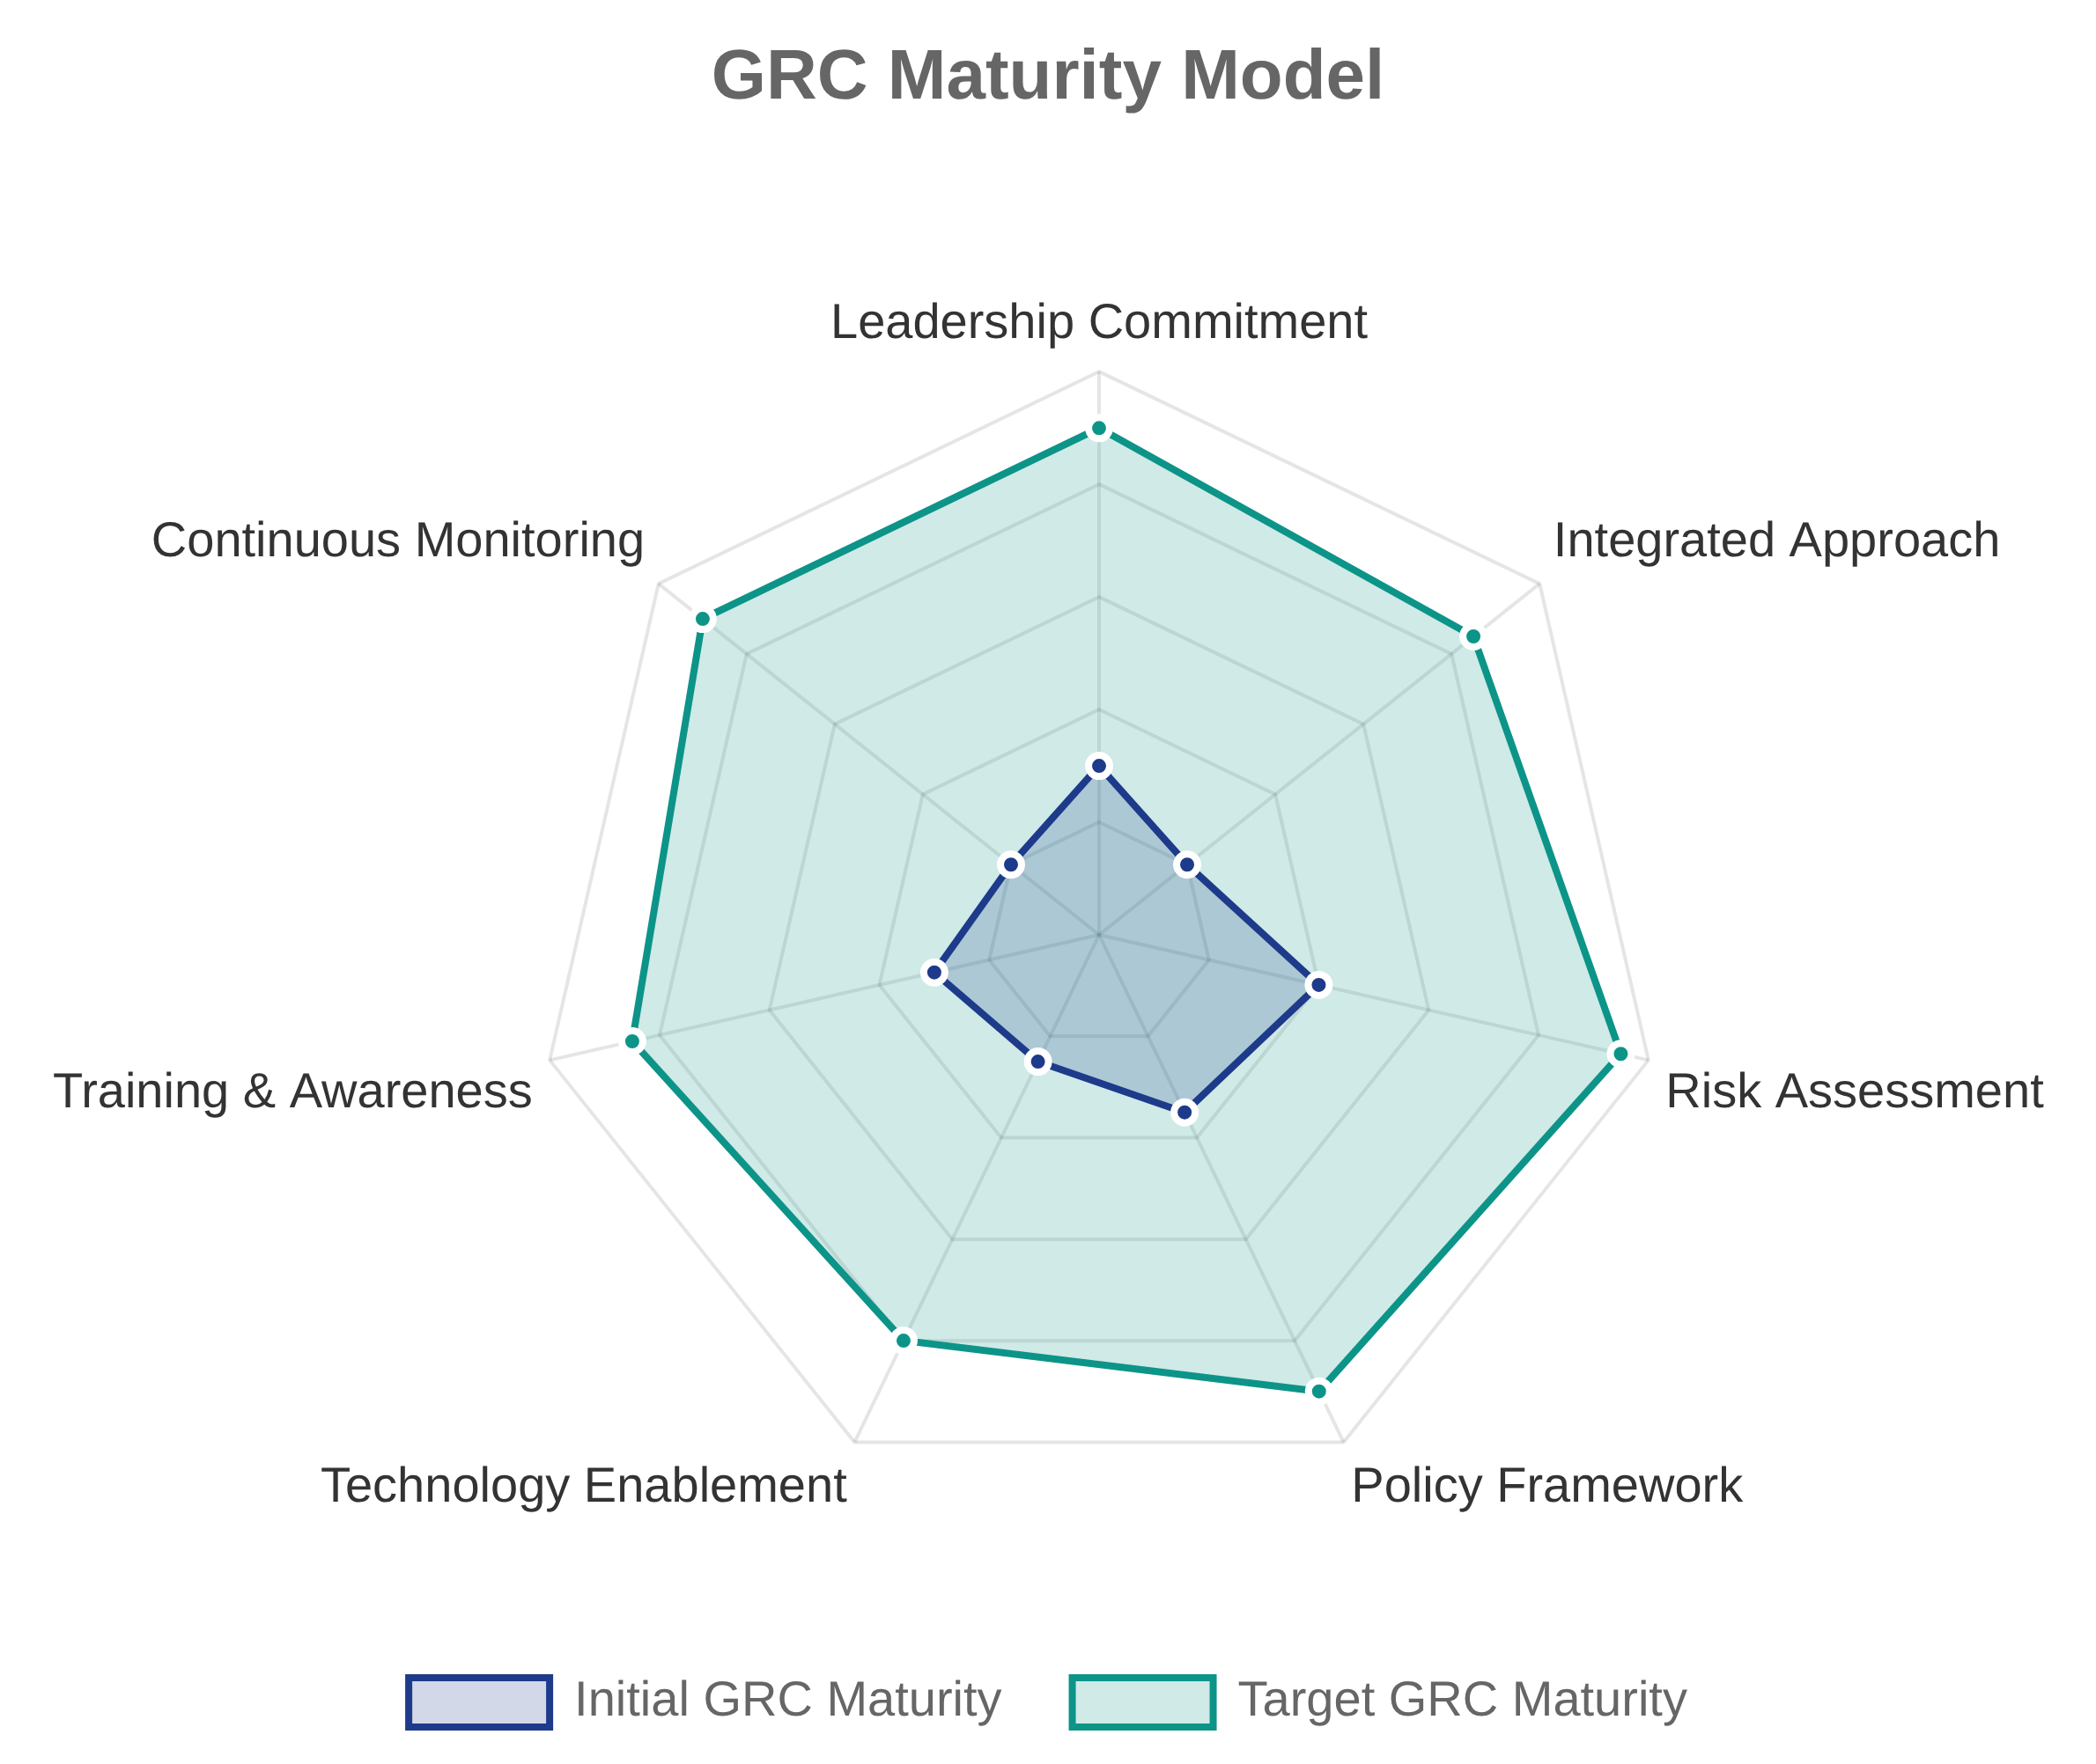


Summary and Next Steps
Key Takeaways
GRC is an integrated approach combining governance, risk management, and compliance to enhance organizational security and efficiency
Effective GRC implementation requires breaking down silos and creating cross-functional collaboration
Multiple frameworks (NIST CSF, COSO, ISO 27001, COBIT) provide structured approaches to GRC implementation
Next Steps
Week 2: Detailed exploration Key regulations: GDPR, HIPAA, PCI-DSS, ISO standards
Week 3: Risk identification, assessment, and mitigation
Week 4: Compliance processes and documentation requirements
GRC101 - International Cybersecurity and Digital Forensics Academy

